Slide 1
Getting Started with PowerShell Jump Start
Jeffrey Snover | Distinguished Engineer & Lead Architect
Jason Helmick | Senior Technologist, Concentrated Technology

Slide 2
02 | Creating web pages using Flask
Susan Ibach | Developer Evangelist
Christopher Harrison | Content Developer

Slide 3
Module Overview
Talking to servers
Routing concepts
Adding functionality

Slide 4
Talking to servers

Slide 5
Talking to servers
Requests and responses
Request contents
Response contents
Making requests

Slide 6
Requests and responses
Request
Information the user sent to the server
Response
Information the server sends to the user

Slide 7
Request contents
URL
Includes the query string
www.example.com/products?id=42
"Replayable"
Anyone with the URL can access the page
Header information
Sent behind the scenes
No size or type restriction
Forms
Files

Slide 8
Response contents
Header information
Used to indicate status codes, file types and other "behind the scenes" information
Content
Typically HTML, CSS or JavaScript

Slide 9
Making requests
Two main "verbs"
GET
Can only send data in URL
Typically used to display forms or information
POST
Can send data in URL or header
Typically used to upload form data

Slide 10



GET in action
I'd like to download a picture of a koala
www.adventure-works.com/SleepingKoala
"Here's the picture!"

Slide 11
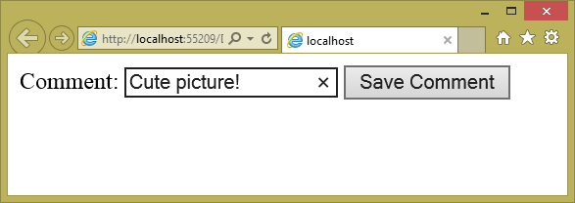
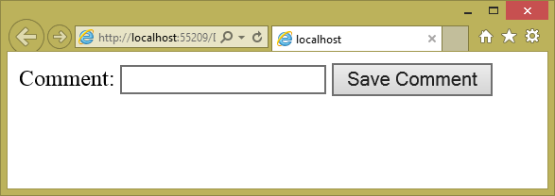
POST in action
I'd like to comment on that picture!
[GET] www.adventure-works.com/Comment
"Here's the form to use!"
[POST] www.adventure-works.com/Comment

Slide 12
Routing concepts

Slide 13
Routing concepts
What is routing?
Routing and Flask
"Vanity URLs"

Slide 14
What is routing?
With many web technologies, users request specific pages
www.example.com/aboutus.html
www.example.com/register.aspx

Slide 15
What is routing?
Most modern shy away from calling specific pages
Request functionality instead
www.example.com/register
www.example.com/about
Advantages
Increased flexibility
Readable or "vanity" URLs

Slide 16
What is routing?
The server needs to understand what the user is requesting
This is routing
Translating a URL to desired item or function

Slide 17
Routing 101

Slide 18
Vanity URLs
Your name in lights!
www.example.com/speakers/SusanIbach
Why is this important?
Search engine optimization
Predictable URLs

Slide 19
Vanity URLs

Slide 20
Creating links

Slide 21
Creating links
To create a link you need the URL
Problem: The URL might change!
Solution: Ask Flask for the URL
"Don't hard code anything you can look up."

Slide 22
Adding links

